Slide 1

ALGORITHMS AND FLOWCHARTS
Introduction
Definition of Algorithms
An algorithm is a set of well-defined steps or instructions used to solve a problem or accomplish a specific task.
Algorithms can be expressed using natural language, pseudocode, or programming languages.
The key characteristic of an algorithm is that it must be effective, meaning that it can produce the correct output for any input within a finite amount of time.
Java Full Stack Program

Slide 2
Importance of Algorithms in problem solving
Algorithms play a crucial role in problem solving by providing a systematic and structured approach to finding solutions. They help to break down complex problems into smaller, more manageable steps that can be easily followed and implemented.
The following are some of the key reasons why algorithms are important in problem solving:
Consistency: Algorithms provide a consistent and repeatable method for solving problems, which helps to reduce the chances of errors and inconsistencies.

Slide 3
2. Efficiency: Algorithms can be optimized to solve problems quickly and efficiently, making them ideal for large and complex problems.
3. Clarity: Algorithms provide a clear and concise representation of the steps involved in solving a problem, which makes it easier for people to understand and implement the solution.
4. Automation: Algorithms can be implemented as computer programs, which can automate repetitive tasks and reduce the amount of manual effort required.
5. Problem abstraction: Algorithms can abstract the details of a problem and provide a high-level view, which makes it easier to identify patterns and find solutions.

Slide 4
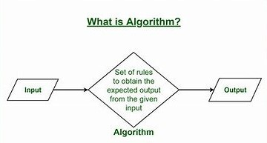
What are Algorithms?
Algorithms are a set of well-defined steps or instructions used to solve a problem or accomplish a specific task.
They are used to automate repetitive tasks and to solve complex problems in a systematic and structured way.
In computer science, algorithms are a fundamental tool for developing computer programs and solving complex problems.

Slide 5
They can be expressed using natural language, pseudocode, or programming languages, and they can be implemented as computer programs.
The main characteristic of an algorithm is that it must be effective, meaning that it can produce the correct output for any input within a finite amount of time.
Algorithms must also be clear and unambiguous, so that they can be executed by a computer or a person following the instructions.
Algorithms are used in a wide range of applications, from simple arithmetic calculations to complex image processing and artificial intelligence systems.
They play a critical role in the functioning of modern technology, including search engines, social media platforms, financial systems, and many others.

Slide 6
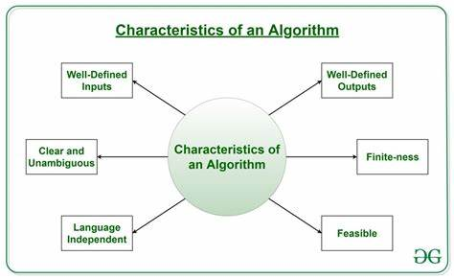
Characteristics of Algorithms
The following are the key characteristics of algorithms:
Input: An algorithm takes one or more inputs, which can be numbers, text, or any other type of data.
Output: An algorithm produces one or more outputs, which can be numbers, text, or any other type of data.

Slide 7
Definiteness: Algorithms must be well-defined and unambiguous, so that they can be executed by a computer or a person following the instructions.
Finiteness: Algorithms must terminate after a finite number of steps and produce the correct output.
Effectiveness: Algorithms must be effective, meaning that they can produce the correct output for any input within a finite amount of time.
Generality: Algorithms must be general, meaning that they can be applied to a wide range of inputs and problems.
Simplicity: Algorithms should be simple and easy to understand, so that they can be easily implemented and maintained.

Slide 8
Types of Algorithms
There are several types of algorithms, including:
Sorting algorithms: These algorithms arrange elements in a particular order, such as ascending or descending order. Examples include bubble sort, quick sort, and merge sort.
Search algorithms: These algorithms search for an item in a data structure, such as an array or a list. Examples include linear search and binary search.
Graph algorithms: These algorithms perform operations on graphs, such as finding the shortest path between two nodes or detecting cycles in the graph.
Dynamic programming algorithms: These algorithms are used to solve problems by breaking them down into smaller sub-problems and solving each sub-problem only once.

Slide 9
Divide and conquer algorithms: These algorithms divide a problem into smaller sub-problems, solve each sub-problem independently, and combine the solutions to obtain the solution to the original problem.
Greedy algorithms: These algorithms make the best choice at each step, without considering the long-term consequences of their choices.
Backtracking algorithms: These algorithms try out different solutions and undo them if they do not lead to a solution.
Randomized algorithms: These algorithms use randomness to solve problems, such as finding a solution or generating random numbers.
These are just a few examples of the types of algorithms that exist. The choice of algorithm depends on the problem being solved and the desired properties of the solution.

Slide 10
Advantages of Algorithms:
Precision: Algorithms provide a precise and well-defined solution to a problem, reducing the chances of error and increasing the reliability of the solution.
Automation: Algorithms can be automated, allowing problems to be solved quickly and efficiently without human intervention.
Consistency: Algorithms provide a consistent solution to a problem, regardless of who is using the algorithm or when it is being used.
Optimization: Algorithms can be optimized to improve their performance, making them faster and more efficient.
Reusability: Algorithms can be reused, saving time and effort when solving similar problems in the future.

Slide 11
Disadvantages of Algorithms:
Complexity: Algorithms can be complex, making them difficult to understand and implement, especially for those who are not familiar with programming or mathematics.
Inflexibility: Algorithms can be rigid and inflexible, making it difficult to adapt them to changing circumstances or new requirements.
Bias: Algorithms can be biased, especially if they are based on flawed or biased data or assumptions.
Lack of creativity: Algorithms can limit creativity, as they provide a fixed solution to a problem rather than allowing for alternative or innovative solutions.
Dependence: Algorithms can create dependence on technology, as they require computers and other forms of technology to work effectively.

Slide 12
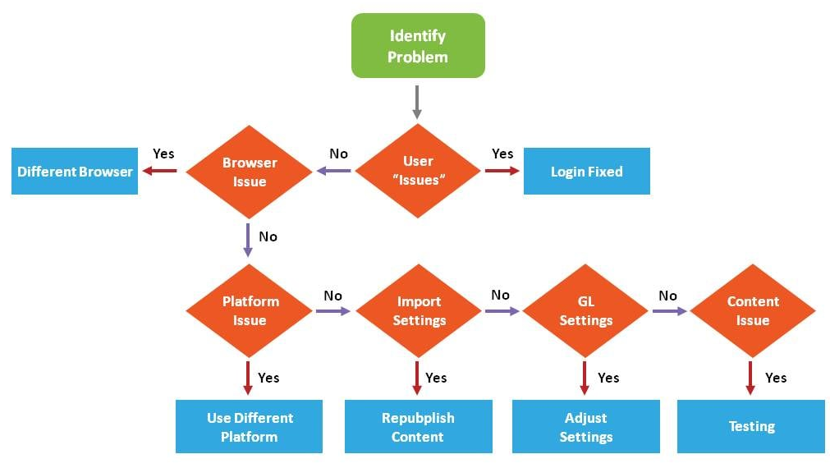
What is a Flowchart?
Flowchart is a graphical representation of an algorithm.
Programmers often use it as a program-planning tool to solve a problem.
It makes use of symbols which are connected among them to indicate the flow of information and processing.

Slide 13
Overview of Flow Charts
Flow charts are widely used in various fields, including business, engineering, and computer science, to document and communicate complex processes.
They are a useful tool for breaking down complex processes into smaller, more manageable steps, making it easier to understand and implement the solution.
The following are the key components of a flow chart:
1. Symbols: Standard symbols are used to represent the different steps or components of a process. For example, a rectangle may represent a process, a diamond may represent a decision, and an arrow may represent the flow of data or control.

Slide 14
2. Arrows: Arrows are used to connect the symbols and show the flow of information, data, or control.
3. Terminals: Terminals represent the start and end points of a process.
4. Connectors: Connectors are used to connect multiple flow charts, or to connect a flow chart to external information.
5. Annotation: Annotation is used to provide additional information or explanations about the flow chart.

Slide 15
How to use it
Process Flowchart is one of the most basic diagram you will meet.
It is a great one to begin with since it is used to describe a high-level process of the whole system.
You don’t have to go into every single edge case here.
It is better just to describe a happy path, showing via what modules or actions User has to go through to complete a certain scenario

Slide 16
Types and Uses of Flowcharts
There are a wide variety of flowchart types.
Here are just a few of the more commonly used ones.
Swimlane flowcharts
Data flow diagrams
Influence diagrams
Workflow diagrams
Process flow diagrams
Yes/no flowcharts
Decision flows

Slide 17
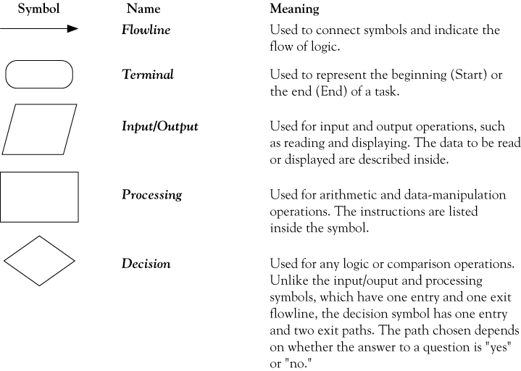
Flowchart symbols

Slide 18
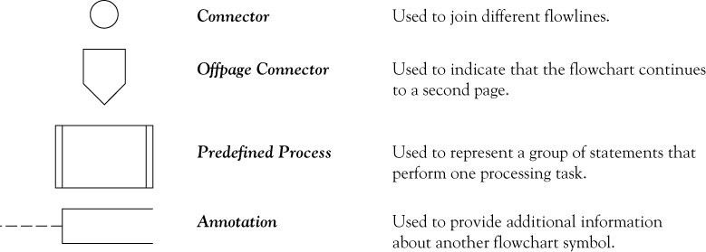
Flowchart symbols continued

Slide 19
Four Flowchart Structures
Sequence
Decision
Repetition
Case

Slide 20
Sequence Structure
A series of actions are performed in sequence.
The pay-calculating example was a sequence flowchart.

Slide 21
Decision Structure
The flowchart segment below shows how a decision structure is expressed in C++ as an if/else statement.
Flowchart
NO
YES
x < y?
if (x < y)
a = x * 2;
else
a = x + y;
Calculate a as x plus y.
Calculate a as x times 2.

Slide 22
Decision Structure
The flowchart segment below shows a decision structure with only one action to perform.
It is expressed as an if statement in C++ code.
Flowchart
C++ Code
NO
YES
x < y?
if (x < y)
a = x * 2;
Calculate a as x times 2.

Slide 23
Repetition Structure
The flowchart segment below shows a repetition structure expressed in C++ as a while loop.
Flowchart
C++ Code
while (x < y)
x++;
YES
x < y?
Add 1 to x

Slide 24
Controlling a Repetition Structure
The action performed by a repetition structure must eventually cause the loop to terminate. Otherwise, an infinite loop is created.
In this flowchart segment, x is never changed. Once the loop starts, it will never end.
QUESTION: How can this flowchart be modified so it is no longer an infinite loop?
YES
x < y?
Display x

Slide 25
Controlling a Repetition Structure
ANSWER: By adding an action within the repetition that changes the value of x.
YES
x < y?
Display x
Add 1 to x

Slide 26
Case Structure
If years_employed = 3, bonus is set to 400
If years_employed is any other value, bonus is set to 800
If years_employed = 2, bonus is set to 200
If years_employed = 1, bonus is set to 100
CASE years_employed
1
2
3
Other
bonus = 100
bonus = 200
bonus = 400
bonus = 800

Slide 27
Advantages of Flow Charts:
Clarity and Understanding: Flow charts provide a clear and concise visual representation of a process, making it easier for people to understand and follow.
Communication: Flow charts can be used as a communication tool to explain a process or decision to others, such as team members, stakeholders, or customers.
Problem Solving: Flow charts can be used to identify and analyze problems in a process, allowing for improvements to be made and increasing efficiency.
Standardization: By using a standardized set of symbols, flow charts provide a consistent and recognizable way of representing processes and decisions.
Traceability: Flow charts can be used to trace the flow of information and control from one step to another, making it easier to identify potential bottlenecks or inefficiencies.

Slide 28
Disadvantages of Flow Charts:
Complexity: For more complex processes, flow charts can become difficult to read and understand, especially if there are many branches and decisions.
Time-Consuming: Creating a flow chart can be time-consuming, especially for complex processes.
Limited Information: Flow charts can only represent a limited amount of information and may not provide a complete picture of a process or decision.
Inflexibility: Once a flow chart is created, it can be difficult to make changes or updates, especially if the process or decision has evolved over time.
Limited Adaptability: Flow charts may not be the best representation tool for certain processes or decisions, such as those that are highly dynamic or involve a large amount of data.

Slide 29
Understanding the solution to given problem
Problem Solving
Today, we use computers in every field for various purposes.
But, we know that they cannot solve the problems all by themselves. Furthermore, we have to give step by step instructions to the computer for solving the problem.
We can define problem-solving as a process of understanding the problem, designing an algorithm for it, and finally implementing the solution to it.
Therefore, we can say that a successful problem-solving process depends on the following factors:
Understanding the problem and defining it precisely.
Designing a proper algorithm (solution) for it.
Implementing the algorithm successfully.

Slide 30
Understanding the Problem
It is very obvious that before finding the solution we should understand the problem well.
Moreover, if we fail to understand the problem we may end up with a useless solution for it.
Hence, a wrong solution will not solve our purpose of problem-solving.
Therefore, we need to read the problem carefully and decide the different functions which the solution will contain.
Moreover, we need to understand that what is the required output and how we can generate it.
Besides, for proper output, we surely need an input.
The input can be single or multiple as per the problem.
Hence, it is quite important to maintain the necessary relationship between the input and the output.

Slide 31
Important points in Understanding the Problem
Some of the important points that we should keep in mind while understanding the problem are as follows:
Read the problem very carefully.
Identify the functions that the solution (algorithm) should have.
Identify the required output.
Find a way to produce the required output.
Draw a proper relationship between the input and output.
Take all the necessary number of inputs.
Avoid unnecessary inputs.
Identify the correct number of the required input.

Slide 32
Further steps in problem-solving
After understanding the problem, the further steps are as follows:
Designing an algorithm
After understanding the relationship between input and output and the functionalities required we have to design an algorithm.
Furthermore, the algorithm should contain all the necessary functions to solve the problem.
Moreover, it should produce a proper output for every input.

Slide 33
Implementing the algorithm
After designing the algorithm we should implement and design a program to solve the problem.
We can develop the program using any programming language.
Evaluation
After developing the program we should run and test if it produces the correct output.

Slide 34
Thank You!

